Slide 1
COGNI-INTENT: STOPPING MEMORY CONFUSION & DRIFT IN LONG‑TERM AI AGENTS
Final Project Review | Department of Artificial Intelligence & Data Science
TEAM MEMBER
2420080098 – TANNISHTHA VERMA
Guide: Dr. Sirisha Potluri
HOD & Course Coordinator: Dr. Sreenath Itikela
Academic Year: 2026–2027 | Semester: Odd
Notes:
Introduce yourself, the project title, your guide and the department.

Slide 2



Introduction & Problem Statement
Background
Naive vector search: asthma notes
Day 1
Long-running AI agents pile up months of memory updates. Standard RAG ranks by cosine similarity alone and cannot tell which notes are outdated.
Prescribed Albuterol inhaler for mild asthma.
Problem Statement
Day 16
Escalated to Symbicort.
Contradictory notes (Albuterol → Symbicort → Flovent) are retrieved together, so the agent may recommend a discontinued drug.
Day 40
Severe palpitations! Discontinue Symbicort, prescribe Flovent.
Motivation / Need
All three notes match “asthma inhaler”, so all three are retrieved and the agent gets confused.
Clinicians and patients need safe, auditable agents. Unchecked memory drift causes confusion, wrong advice and lost history.
Notes:
Explain the clinical example: Day 1 Albuterol, Day 16 Symbicort, Day 40 Flovent. Naive RAG retrieves all three.

Slide 3


Objectives & Scope
Objectives
In Scope
1
Design a drift-aware memory store: 384-D Sentence-BERT vectors with timestamp, relevance and lineage metadata.
Clinical-note memory (asthma scenario), drift detection, Golden Fact healing, soft archiving, simulation lab and FastAPI backend.
2
Develop unsupervised drift detection (UMAP + HDBSCAN + NLI) that flags a breach when MHS < 0.75.
3
Implement LLM healing that merges conflicting notes into one NLI-verified Golden Fact.
Out of Scope
Real patient data and HIPAA compliance, diagnosis or treatment advice, multi-agent memory sharing, production-scale benchmarks.
4
Evaluate safe soft-archiving that keeps 100% of history via supersedes_ids lineage.
Notes:
Walk through the four objectives, then state clearly what is in and out of scope.

Slide 4

Literature Survey
S.No | Author(s) & Year | Method / Technique | Key Findings | Limitation / Gap
1 | Lewis et al., 2020 | Retrieval-Augmented Generation (RAG) | Dense retrieval plus an LLM improves knowledge-intensive tasks | Ranks by similarity only; ignores superseded facts
2 | Park et al., 2023 | Generative Agents memory stream | Retrieval scored by recency, importance and relevance | No check for contradictory memories
3 | Reimers & Gurevych, 2019 | Sentence-BERT embeddings | Fast sentence vectors compared by cosine similarity | Similar ≠ consistent: opposites can sit close
4 | McInnes et al., 2017–18 | HDBSCAN + UMAP | Density clustering with no preset cluster count; UMAP cuts dimensions | Finds clusters but cannot judge contradiction
Research Gap
Existing RAG and agent-memory systems retrieve by similarity and recency, but never verify or resolve contradictions. Cogni-Intent adds NLI-verified detection, Golden Fact merging and soft-archived lineage (Objectives 2–4).
Notes:
Each paper is relevant but none verifies contradictions. That is the research gap.

Slide 5





Proposed System & Methodology
STEP 1
STEP 2
STEP 3
STEP 4
STEP 5
Define Problem
Ingest & Encode
Detect Drift
Heal Memory
Archive & Test
Memory confusion in long-term agents. Success: MHS ≥ 0.75.
Filter notes, embed with SBERT (384-D), tag metadata in ChromaDB.
UMAP + HDBSCAN find clusters; NLI scores contradictions into MHS.
LLM merges the cluster into a Golden Fact; NLI verifies it.
Soft-archive old notes, link lineage, test in doctor chat.
Key Novelty / Contribution
Unlike similarity-only RAG, Cogni-Intent is a memory immune system: it detects contradictions on its own, merges them into verified Golden Facts and archives (never deletes) old records for zero data loss.
Notes:
Walk the five steps left to right, then state the novelty: detect, merge, archive, never delete.

Slide 6
System Architecture
Components
Clinical notes
agent input
NLP filter + SBERT
384-D embedding
1 ChromaDB store
cosine · HNSW · metadata
1
Vector Store
ChromaDB, 384-D cosine space
2 MLOps drift daemon · scans every 60 s
2
Drift Detector
UMAP + HDBSCAN + NLI → MHS
UMAP
384-D → 2-D
HDBSCAN
density clusters
Cross-encoder NLI
contradiction → MHS
3
LLM Healer
Golden Fact, NLI-verified
MHS < 0.75
MHS ≥ 0.75
healthy: no action
3 LLM healer
Golden Fact + NLI guardrail
4 Archive
is_archived + lineage
4
Archive & API
Soft-evict, lineage, FastAPI
Notes:
Follow the flow: input → encoder → ChromaDB → 60 s daemon → healer → archive.

Slide 7


Hardware & Software Requirements
Hardware
Software & Tools
Libraries / Frameworks
Laptop / desktop PC (CPU-only)
Local disk for ChromaDB store
Internet for Gemini API (optional)
Modern web browser for the UI
Windows / Linux / macOS
Python 3.9+
HTML, CSS and JavaScript UI
Git and GitHub (GitHub Pages)
sentence-transformers (MiniLM)
ChromaDB (HNSW index)
umap-learn and hdbscan
FastAPI, DeBERTa-v3 NLI, Gemini
Deployment / Platform: Local FastAPI server (localhost:8080) and GitHub Pages (client-side engine)
Notes:
Everything runs on a normal laptop; the Gemini API is optional.

Slide 8
Dataset / Data Understanding
Sample memory records (ChromaDB)
384
3
Day | Clinical note
1 | Patient prescribed Albuterol inhaler for mild asthma.
16 | Escalated to Symbicort.
40 | Severe heart palpitations! Discontinue Symbicort immediately, prescribe Flovent.
Embedding dimensions
Notes in core scenario
0.75
60 s
MHS drift threshold
Daemon scan interval
Metadata schema per vector
{ "patient_id": "123",
"data_type": "medication",
"timestamp": <unix float>,
"relevance_score": <0.0 – 1.0>,
"is_consolidated": false, "is_archived": false,
"supersedes_ids": [ ] }
Source: simulated clinical scenarios (Albuterol → Symbicort → Flovent)
Fields: note text, timestamp, relevance_score, is_consolidated, is_archived, supersedes_ids
Quality: notes contradict by design; nothing is deleted
Notes:
The data are simulated clinical scenarios. Show the metadata schema.

Slide 9



Data Preprocessing & Exploratory Analysis
Encoding pipeline: raw note → memory vector
Raw note
free-text clinical entry
Importance filter
keep atomic facts, drop filler
SBERT pooling
mean-pooled 384-D vector
Metadata tag
timestamp · relevance
Cleaning
Transformation
Feature Selection
NLP importance filter keeps atomic facts and discards conversational filler.
all-MiniLM-L6-v2 with mean pooling gives 384-D vectors in cosine space.
UMAP maps 384-D to 2-D before HDBSCAN; metadata fields guide healing.
Notes:
Decay lowers relevance as memories age; the pipeline turns text into 384-D vectors with metadata.

Slide 10
Module-wise Description
1
Drift-Aware Ingestion & Storage
2
Drift Detection Engine
Purpose: Filter and embed notes, store in ChromaDB
Input → Output: Raw note → 384-D vector + metadata
Developed by: Tannishtha Verma
Purpose: Find clusters and score contradictions (MHS)
Input → Output: Stored vectors → clusters + MHS
Developed by: Tannishtha Verma
3
Healing & Archiving Engine
4
API & Simulation Lab UI
Purpose: Merge conflicts, verify, soft-archive old notes
Input → Output: Breached cluster → Golden Fact + lineage
Developed by: Tannishtha Verma
Purpose: Run scenarios, doctor chat before / after healing
Input → Output: User query → answer + memory view
Developed by: Tannishtha Verma
Notes:
Four modules, all developed by you. Be ready to explain each input and output.

Slide 11

Algorithms & Technologies Used
Sentence-BERT
UMAP + HDBSCAN
NLI + LLM Healing
Why chosen
Compact 384-D vectors cut memory footprint by 75% vs 1536-D.
Key parameters
all-MiniLM-L6-v2, mean pooling, cosine
Why chosen
Density clustering needs no preset cluster count; runs in O(N log N).
Key parameters
384-D → 2-D, density-based clusters
Why chosen
NLI confirms real opposition; LLM merges it into a Golden Fact.
Key parameters
DeBERTa-v3 NLI, Gemini, MHS < 0.75
Selection criteria: Chosen for low memory cost, no preset cluster count and fewer false alarms via NLI checks.
Notes:
Explain why each technique was chosen and its key parameters.

Slide 12
Implementation / Model Building
Feature Selection
Code snippet / pseudocode
384-D SBERT embedding plus timestamp, relevance_score and is_consolidated metadata.
# Pseudocode: MLOps daemon loop
while True:
vecs = store.get_active()
xy = umap.fit_transform(vecs)
labels = hdbscan.fit_predict(xy)
for c in clusters(vecs, labels):
mhs = health_score(nli, c)
if mhs < 0.75: # drift breach
gold = llm.merge(c)
if nli.verify(gold, c):
store.archive(c)
store.add(gold, supersedes=c.ids)
sleep(60)
Preprocessing Pipeline
Importance filter → atomic facts → mean-pooled embedding → UMAP 2-D.
Memory Store Design
Active vs archived records; each Golden Fact links old notes via supersedes_ids.
Configuration
Decay rate, max cluster density, contradiction threshold (MHS 0.75), 60 s scan.
Notes:
Describe the pseudocode of the daemon loop; mention it is simplified.

Slide 13
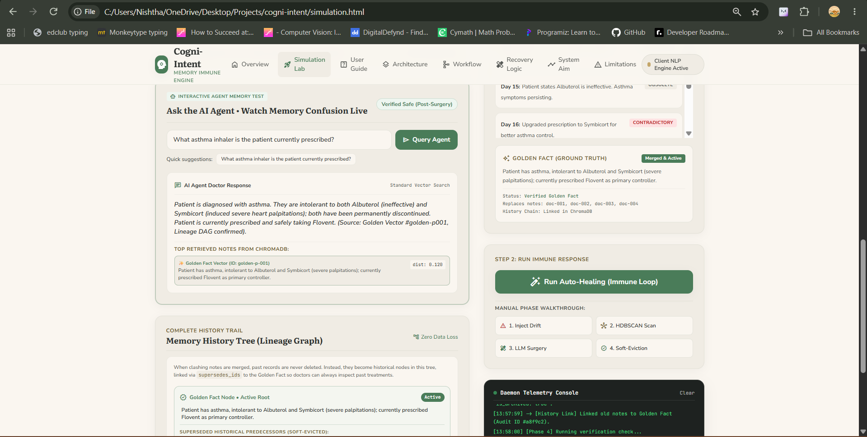
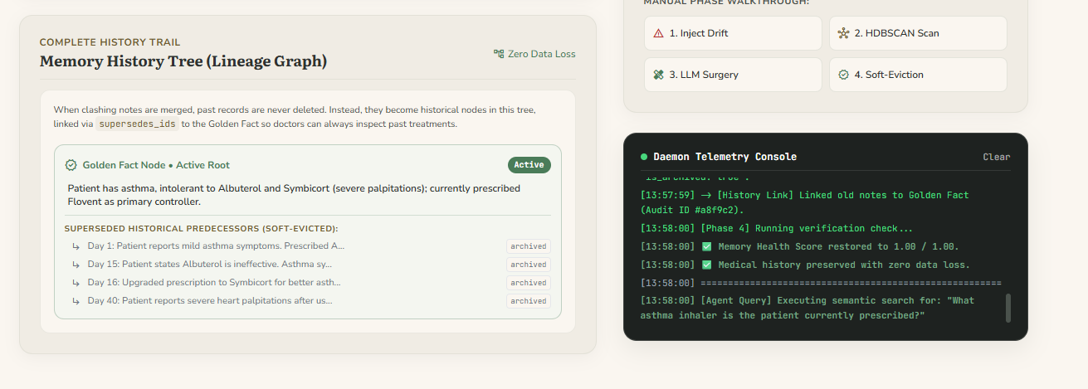
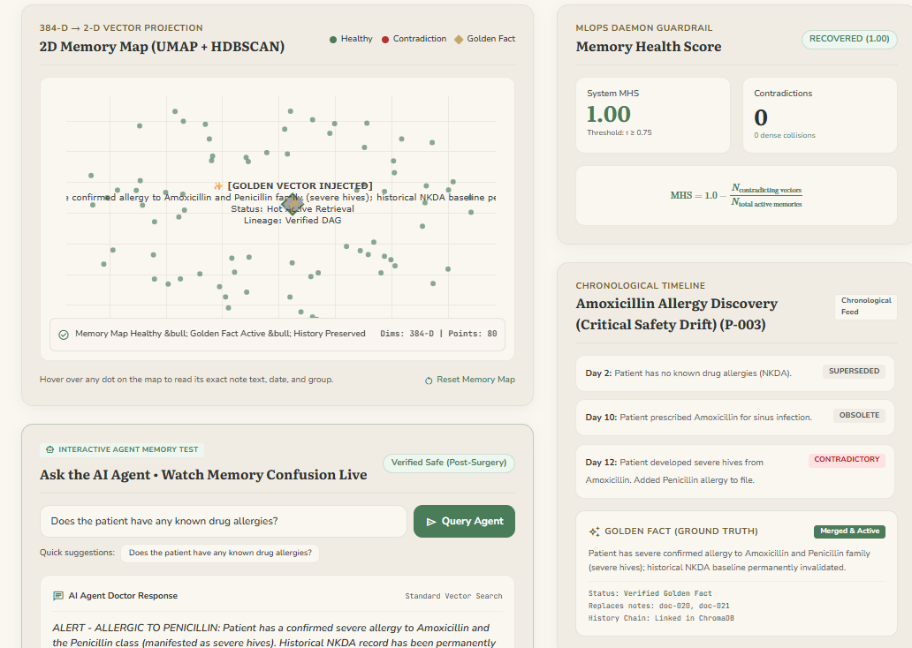
Working Prototype / Output Screens
[Insert screenshot: simulation.html scenario picker and doctor chat, before healing]
[Insert screenshot: auto-healing immune loop with MHS breach]
[Insert screenshot: Golden Fact and history tree after healing]
Simulation Lab: Before Healing
Doctor chat shows confusion and warnings across all three notes
Auto-Healing Immune Loop
MHS drops below 0.75 and triggers merge into a Golden Fact
After Healing: Golden Fact
Verified answer; older notes archived, not deleted
Notes:
Insert real screenshots from simulation.html before presenting.

Slide 14
Results & Performance Comparison
Metric | Naive RAG | Cogni-Intent | Change
Active notes retrieved | 3 | 1 | −2
Stale notes surfaced | 2 | 0 | −2
Lineage links kept | 0 | 3 | +3
Embedding size | 1536-D | 384-D | −75%
Unsafe drug advice | Possible | Blocked | —
Best: Cogni-Intent – 3 notes → 1 Golden Fact, 0 stale
Values come from the Albuterol → Symbicort → Flovent scenario; the 1536-D figure is the README baseline.
Live Link: https://tannishtha3183.github.io/cogni-intent/index.html
Notes:
Explain the comparison: 3 active notes down to 1, no stale notes, 3 lineage links.

Slide 15
Analysis & Key Findings
Before healing
After healing
3 → 1
Day 1
Albuterol for mild asthma
GOLDEN FACT
Asthma; intolerant to Symbicort / Albuterol; currently prescribed Flovent
Active notes for the asthma query after healing
Day 16
Escalated to Symbicort
Interpretation: One Golden Fact replaces three conflicting notes, so the agent answers with Flovent.
Error analysis: LLM merges can hallucinate; the NLI guardrail rejects unsupported Golden Facts.
Key drivers: MHS threshold 0.75, NLI verification and soft archiving.
Day 40
Stop Symbicort, use Flovent
Archived (is_archived: true)
Day 1
Day 16
Day 40
linked by supersedes_ids
Same query, same data: naive search returns 3 conflicting notes, Cogni-Intent returns 1 verified fact.
Notes:
Interpret the before/after diagram and be candid about LLM hallucination risk.

Slide 16

Testing & Validation
Test ID | Test Description | Expected Result | Actual Result | Status
TC-01 | NLP encoding of a clinical note | 384-D embedding vector | Checked by run_tests.py | Automated
TC-02 | ChromaDB soft-eviction | Record flagged is_archived, not deleted | Checked by run_tests.py | Automated
TC-03 | Drift detection on conflicting notes | MHS < 0.75 flags the cluster | Checked by run_tests.py | Automated
TC-04 | Healer output schema | Golden Fact with supersedes_ids | Checked by run_tests.py | Automated
Functional Testing
Validation Method
Performance Testing
Automated suite: python tests/run_tests.py covers encoding, soft-eviction, drift and healer.
Doctor-chat sandbox: same query asked before and after healing.
Daemon runs every 60 s; canary probe queries check retrieval of known truths.
Notes:
Run python tests/run_tests.py before presenting and update the Status column with Pass / Fail.

Slide 17


Challenges & Limitations
Challenges Faced
Limitations
Hard deletion erases history → soft-archive with is_archived and supersedes_ids lineage
LLM merges may hallucinate → cross-encoder NLI verifies every Golden Fact
Brittle similarity thresholds → UMAP to 2-D, then density-based HDBSCAN
No server on GitHub Pages → dual-engine design with a client-side fallback
Evaluated on simulated clinical scenarios, not real patient records
Golden Fact quality depends on the LLM and its API availability
Periodic 60 s scan: a contradiction can persist until the next pass
Notes:
Pair each challenge with its fix, and be honest about limitations.

Slide 18

Conclusion
Built Cogni-Intent: ChromaDB memory with 384-D SBERT, UMAP + HDBSCAN, NLI guardrails and LLM healing.
1
Final Outcome
In the asthma scenario, 3 conflicting notes become 1 Golden Fact; 0 stale notes surface versus 2 in naive RAG.
3 → 1
2
Active notes after healing, with 100% of history preserved
Objectives achieved: 4 of 4
All four objectives are met, with an auditable history tree and a browser or FastAPI deployment.
3
Notes:
Revisit each objective; do not add new material.

Slide 19



Future Scope & Applications
Improve Performance
Tune MHS per domain and benchmark on larger real-world memory sets.
Applications
Clinical AI assistants and patient records
Legal and compliance case memory
Long-term personal AI assistants
Adopters: hospitals, law firms, AI product teams
Expand Data / Features
Multi-patient and multi-agent memory, more domains, richer metadata.
Deploy & Build an Interface
Live MHS gauge, lineage history tree and a hosted REST API.
Scale & Secure
Cloud deployment, PHI privacy controls, MLflow canary monitoring.
Notes:
Tie each next step to a limitation, then name applications.

Slide 20
Team Contribution
Reg. No. | Name | Contribution / Modules Handled
2420080098 | Tannishtha Verma | Sole developer: problem design, architecture, all four modules, simulation lab, testing, report and presentation
— | Dr. Sirisha Potluri (Guide) | Project guidance, technical review and feedback
— | Dr. Sreenath Itikela (HOD & Course Coordinator) | Academic oversight and course coordination
Notes:
State your own role and acknowledge your guide and HOD.

Slide 21

References
[1] P. Lewis et al., “Retrieval-augmented generation for knowledge-intensive NLP tasks,” in Proc. NeurIPS, vol. 33, 2020, pp. 9459–9474.
[2] J. S. Park et al., “Generative agents: Interactive simulacra of human behavior,” in Proc. ACM UIST, 2023.
[3] N. Reimers and I. Gurevych, “Sentence-BERT: Sentence embeddings using Siamese BERT-networks,” in Proc. EMNLP-IJCNLP, 2019, pp. 3982–3992.
[4] L. McInnes, J. Healy, and S. Astels, “hdbscan: Hierarchical density based clustering,” J. Open Source Softw., vol. 2, no. 11, p. 205, 2017.
[5] L. McInnes, J. Healy, and J. Melville, “UMAP: Uniform manifold approximation and projection for dimension reduction,” arXiv:1802.03426, 2018.
[6] P. He, J. Gao, and W. Chen, “DeBERTaV3: Improving DeBERTa using ELECTRA-style pre-training,” in Proc. ICLR, 2023.
[7] Chroma, “Chroma: The AI-native open-source embedding database,” [Online]. Available: https://www.trychroma.com/
Project Links
GitHub: github.com/<user>/cogni-intent
Dataset: Simulated scenarios (in repo)
Demo: simulation.html (Live Lab)
Notes:
Replace the GitHub URL with your real repository link.

Slide 22
THANK YOU
Questions & Discussion
Tannishtha Verma | Roll No. 2420080098 | Dept. of AI & Data Science
Guide: Dr. Sirisha Potluri | HOD: Dr. Sreenath Itikela
Notes:
Leave this slide up during questions.

